Slide 1
Java Data Structures
Università di Modena e Reggio Emilia
Prof. Nicola Bicocchi (nicola.bicocchi@unimore.it)

Slide 2
Framework
The Java Collection Framework (JCF) is a set of classes and interfaces implementing commonly reusable data structures.
The JCF (package java.util) provides
interfaces defining functionalities
abstract classes for shared code aggregation
concrete classes implementing functionalities
algorithms (java.util.Collections)

Slide 3
Key Concepts
Resizable Array
Linked List
Balanced Tree
Hash Table

Slide 4
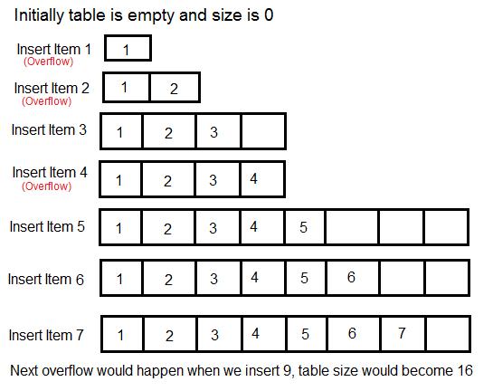
Resizable Array ~O(n)

Slide 5
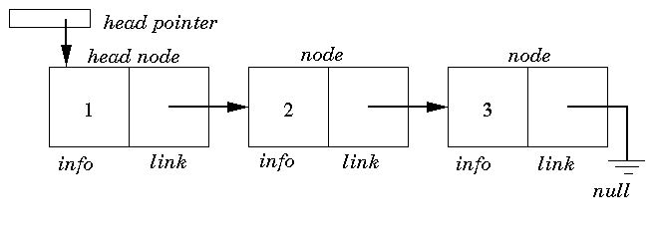
Linked List ~O(n)

Slide 6
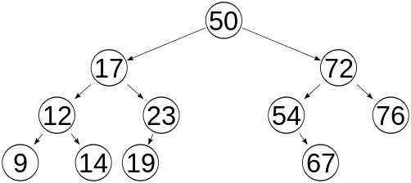
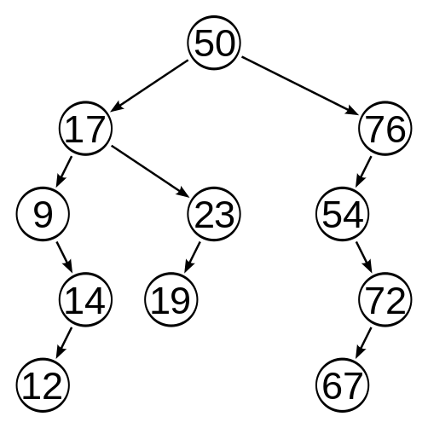
Balanced Tree ~O(log(n))
* A binary tree is balanced if, for each node it holds that, the number of inner nodes in the left subtree and the number of inner nodes in the right subtree differ by at most 1. A binary tree is balanced if for any two leaves the difference of the depth is at most 1.

Slide 7
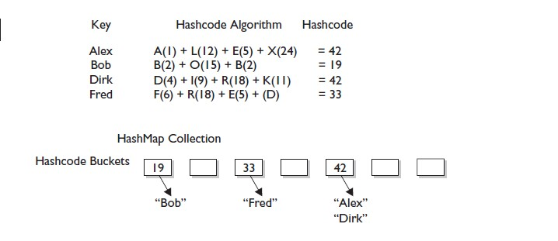
Hash Table ~O(1)
collection->mycollection->myhashmap

Slide 8
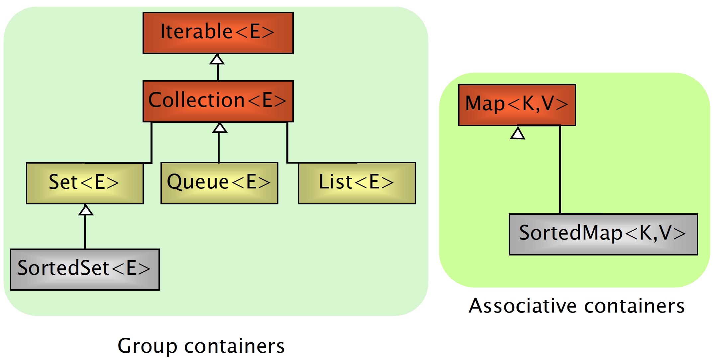
Interfaces

Slide 9
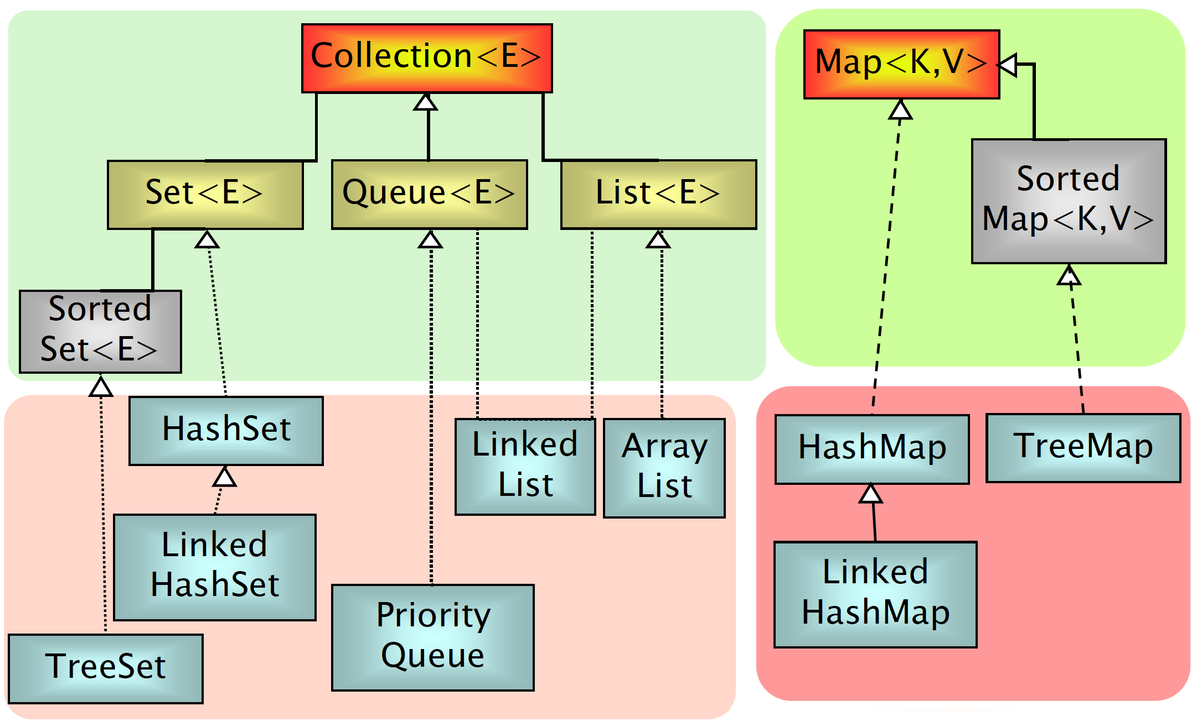
Implementations

Slide 10
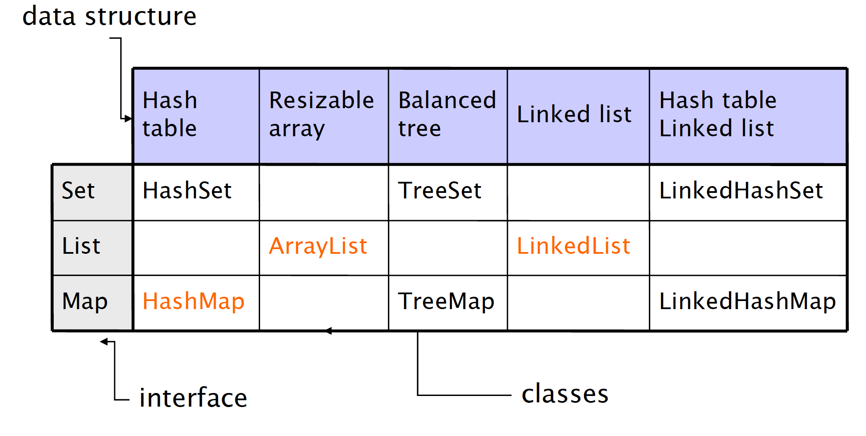
Internals

Slide 11
Iterable and Iterator Interfaces
The Iterable interface (java.lang.Iterable) is the root interface of the Java collection framework. Iterable, literally, means that “can be iterated”.
Technically, it means that an Iterator can be returned. Iterable objects (objects implementing the iterable interface) can be used with the for-each loop
public interface Iterable<T> {
Iterator<T> iterator();
}
List<Object> l = new ArrayList<Object>();
for(Object o : l){
//do something;
}
The Iterator interface extracts the traversal behaviour of a collection into a separate object called an iterator.
https://refactoring.guru/design-patterns/iterator
public interface Iterator<T> {
boolean hasNext()
T next()
void remove()
}
ArrayList<Object> l = new ArrayList<Object>();
for (Iterator<Object> i = l.iterator(); i.hasNext();) {
Object o = i.next();
// do something
}

Slide 12
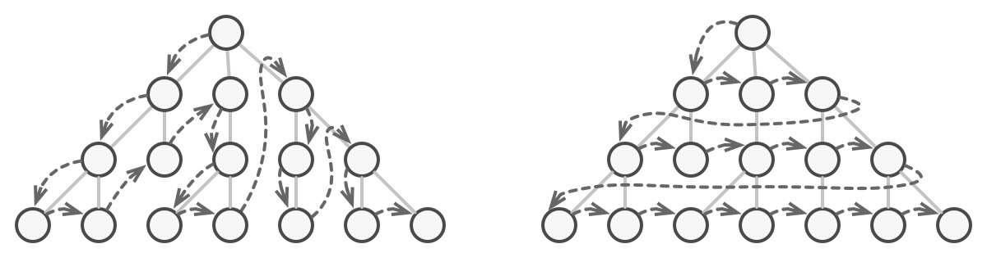
Iterable and Iterator Interfaces

Slide 13
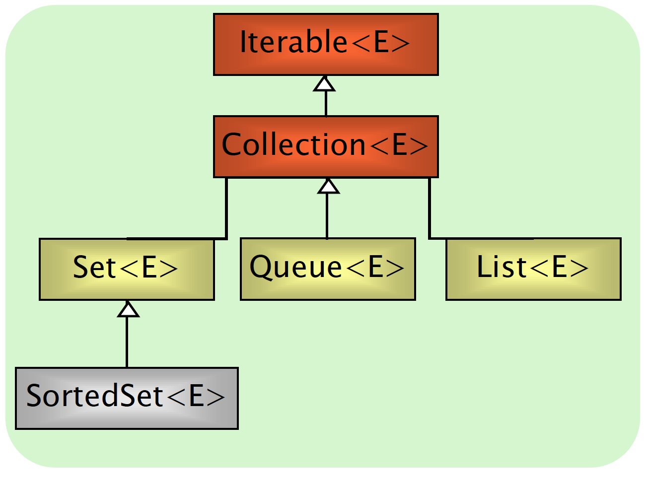
Collection Interface
Group of elements (references to objects)
It is not specified whether they are
Ordered / not ordered
Duplicated / not duplicated
Common constructors
Collection()
Collection(Collection c)
Viene specificato nelle figlie

Slide 14
Collection Interface
int size()
boolean isEmpty()
boolean contains(Object element)
boolean containsAll(Collection c)
boolean add(Object element)
boolean addAll(Collection c)
boolean remove(Object element)
boolean removeAll(Collection c)
void clear()
Object[] toArray()
Iterator iterator()

Slide 15
List Interface
Can contain duplicate elements
Insertion order is preserved
User can select arbitrary insertion points
Elements can be accessed by position

Slide 16
List additional methods
Object get(int index)
Object set(int index, Object o)
Object remove(int index)
void add(int index, Object o)
boolean addAll(int index, Collection c)
int indexOf(Object o)
int lastIndexOf(Object o)
List subList(int fromIndex, int toIndex)

Slide 17
List Initialization
/* plain, simple, long */
List<Integer> l = new ArrayList<Integer>();
l.add(14);
l.add(73);
l.add(18);
…
/* more compact version (mutable)*/
List<Integer> l = new ArrayList<>(Arrays.asList(14, 73, 18));
List<Integer> l = new ArrayList<>(List.of(14, 73, 18));
/* more compact version (immutable)*/
List<Integer> l = List.of(14, 73, 18);

Slide 18
List Implementations
Decoupling references from actual objects allows to change implementation (and related performance!) by changing a single line of code!
List<Car> garage;
garage = new LinkedList<Car>();
garage = new ArrayList<Car>();
garage.add(new Car());
garage.add(new SDCar());
garage.add(new SDCar());
garage.add(new Car());
for(Car c : garage) {
c.turnOn();
}

Slide 19
List Implementations
ArrayList implements List
get(index) -> Constant time
add(index, obj) -> Linear time
LinkedList implements List, Deque
get(index) -> Linear time
add(index, obj) -> Linear time (but more lightweight)

Slide 20
List Implementations
ArrayList retrieval: approx O(1)
ArrayList insertion(end): approx O(1)
ArrayList insertion(beginning): approx O(n)

Slide 21
List Implementations
LinkedList retrieval: approx O(n)
LinkedList insertion(end): approx O(n)
LinkedList insertion(beginning): approx O(1)
In java fx->collections controlla a casa

Slide 22
Set Interface
Contains no methods other than those inherited from Collection
No duplicate elements are allowed

Slide 23
Set Implementations
HashSet implements Set
Hash tables as internal data structure (fast!)
Insertion order not preserved
LinkedHashSet extends HashSet
Insertion order preserved
TreeSet implements SortedSet (an extension of Set)
R-B trees as internal data structure (provide ordering)
User definable internal ordering TreeSet(Comparator c)
Slow when compared to hash-based implementations

Slide 24
Set Implementations
List<String> l = List.of("Nicola", "Agata", "Marzia", "Agata");
Set<String> hs = new HashSet<>(l);
System.out.println(hs);
// [Marzia, Nicola, Agata]
Set<String> lhs = new LinkedHashSet<>(l);
System.out.println(lhs);
// [Nicola, Agata, Marzia]
Set<String> ts = new TreeSet<>(l);
System.out.println(ts);
// [Agata, Marzia, Nicola]

Slide 25
TreeSet Internal Ordering
Depending on the constructor used, SortedSet implementations can use different orderings
TreeSet()
Natural ascending ordering
Elements must implement the Comparable Interface
TreeSet(Comparator c)
Ordering is defined by the Comparator c

Slide 26
HashSet vs TreeSet
HashSet stores the objects in random order, whereas TreeSet applies the natural order of the elements.
HashSet can store null objects, while TreeSet does not allow them.
HashSet provides constant-time performance for most operations like add(), remove() and contains(), versus the log(n) time offered by the TreeSet.
TreeSet is richer in functionalities, implementing additional methods like: first(), last(), ceiling(), lower(), …
Summary:
If we want to keep our entries sorted, we need to go for the TreeSet
If we value performance more than memory consumption, we should go for the HashSet
If we are short on memory, we should go for the TreeSet
If we want to access elements that are relatively close to each, we might want to consider TreeSet because it has greater locality

Slide 27
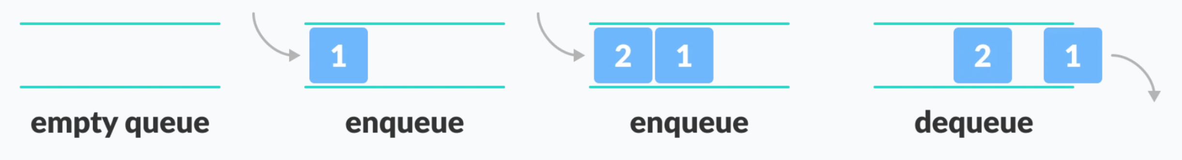
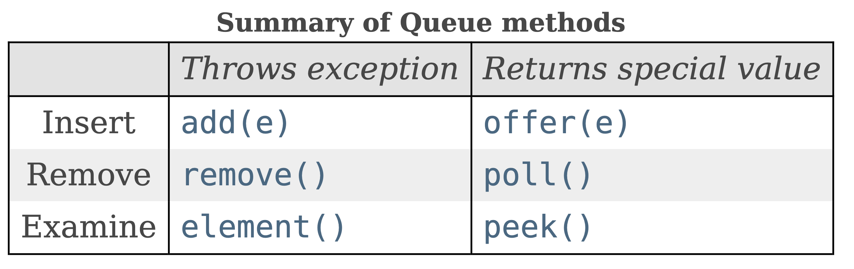
Queue Interface
Queue: a collection designed for holding elements prior to processing. Besides basic Collection operations, queues provide additional insertion, extraction, and inspection operations. Each of these methods exists in two forms: one throws an exception if the operation fails, the other returns a special value (either null or false, depending on the operation).
Si comporta quasi come lo stack

Slide 28
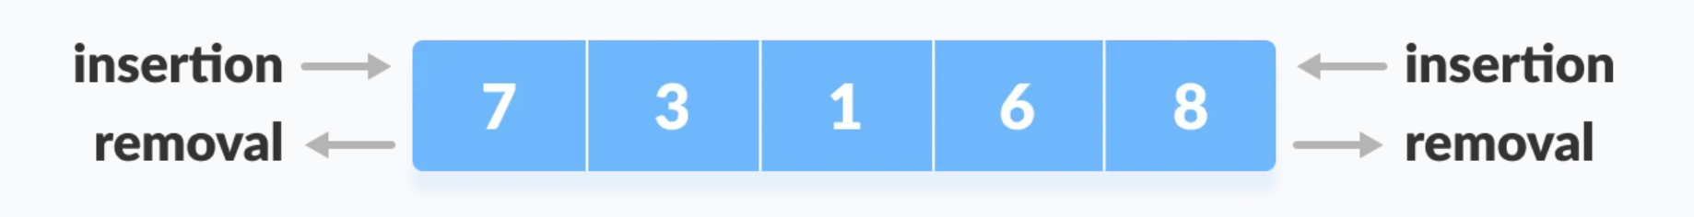
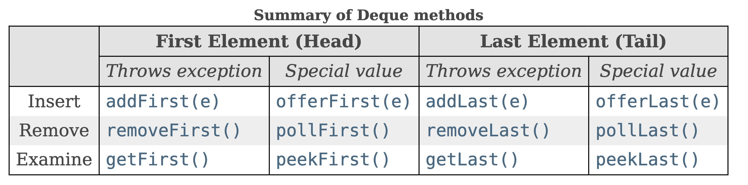
Deque Interface
Deque (extends Queue): A linear collection that supports element insertion and removal at both ends. The name deque is short for "double ended queue" and is usually pronounced "deck". Most Deque implementations place no fixed limits on the number of elements they may contain, but this interface supports capacity-restricted deques as well as those with no fixed size limit.
È una queue che mi permette di intervenire anche alla fine di una coda

Slide 29
Queue Implementations
PriorityQueue implements Queue
No capacity restrictions.
Elements are ordered.
LinkedList implements List, Queue, Deque
ArrayDeque implements Deque
No capacity restrictions.
Null elements are prohibited.
ArrayBlockingQueue implements queue
-Limited capacity
-elements are not ordered

Slide 30
Queue Example
List<Integer> l = List.of(3, 1, 2);
Queue<Integer> fifo = new LinkedList<Integer>(l);
Queue<Integer> pqueue = new PriorityQueue<Integer>(l);
System.out.println(fifo.peek()); // 3
System.out.println(pqueue.peek()); // 1

Slide 31
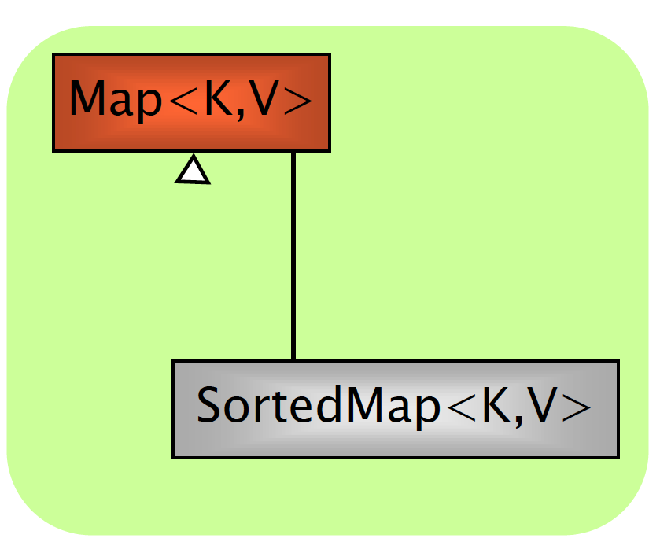
Map Interface
An object storing pairs of (key, value)
(e.g., key: surname, value: phone number)
Keys and values must be objects
Keys must be unique
Common constructors:
Map()
Map(Map m)

Slide 32
Map Interface
Object put(Object key, Object value)
Object get(Object key)
Object remove(Object key)
boolean containsKey(Object key)
boolean containsValue(Object value)
public Set keySet()
public Collection values()
public Set entrySet()
int size()
boolean isEmpty()
void clear()

Slide 33
Map Implementations
HashMap implements Map
Hash tables as internal data structure (fast!)
Insertion order not preserved
LinkedHashMap extends HashMap
Insertion order preserved
TreeMap implements SortedMap
R-B trees as internal data structure
User definable internal ordering
Slow when compared to hash-based implementations
* Similar to Set implementations
Map<Integer, String> src; src = new HashMap<>(); src.put(77, "Nicola"); src.put(17, "Marzia"); src.put(22, "Agata"); System.out.println(src);
// {17=Marzia, 22=Agata, 77=Nicola} src = new LinkedHashMap<>(); src.put(77, "Nicola"); src.put(17, "Marzia"); src.put(22, "Agata"); System.out.println(src);
// {77=Nicola, 17=Marzia, 22=Agata} src = new TreeMap<>(); src.put(77, "Nicola"); src.put(17, "Marzia"); src.put(22, "Agata"); System.out.println(src);
// {17=Marzia, 22=Agata, 77=Nicola}

Slide 34
Map Example I
Map<String, Integer> m = new HashMap<>();
m.put(“Agata”, 2);
m.put(“Marzia”, 3);
m.put(“Agata”, 4);
m.put(“Nicola”, 1);
/* more compact version */
Map<String, Integer> m = new HashMap<>(
Map.of(“Agata”, 2, “Marzia”, 3, “Agata”, 4, “Nicola”, 1));
/* immutable version */
Map<String, Integer> m =
Map.of(“Agata”, 2, “Marzia”, 3, “Agata”, 4, “Nicola”, 1);

Slide 35
Map Example II
Map<String, Integer> m = new HashMap<String, Integer>();
…
// contains key
if (m.containsKey(key)) {
System.out.println(m.get(key));
}
// looping keys and accessing values
Set<String> keys = m.keySet();
for(String key : keys) {
System.out.println(key + " -> " + m.get(key));
}
// looping values
List<Integer> values = m.values();
for(int value : values) {
System.out.println(value);
}
// looping entries
for (Map.Entry<String, Integer> entry : m.entrySet()) {
System.out.println(entry.getKey());
System.out.println(entry.getValue());
}

Slide 36
Collections and Iterators
It is unsafe to modify (adding or removing elements) a Collection while iterating over it!
List<Double> l = new LinkedList<Double>(
List.of(10.8, 11.1, 13.2, 30.2));
int count = 0;
for (double i : l) {
if (count == 1) l.remove(count);
if (count == 2) l.add(22.3);
count++;
} // Run-time error! We modify the list while iterating

Slide 37
Iterator and ListIterator Interfaces
Interface Iterator provides a transparent means for cycling through all elements of a Collection (forward only) and removing elements
boolean hasNext()
Object next()
void remove()
Interface ListIterator provides a transparent means for cycling through all elements of a Collection (forward and backward) and removing and adding elements
boolean hasNext()
boolean hasPrevious()
object next()
object previous()
void add()
void set()
void remove()
int nextIndex()
int previousIndex()

Slide 38
Iterator and ListIterator Interfaces
List<Double> l = new LinkedList<Double>(
List.of(10.8, 11.1, 13.2, 30.2));
int count = 0;
for (Iterator<Double> i = l.iterator(); i.hasNext();) {
double d = i.next();
if (count == 1) i.remove();
count++;
}
List<Double> l = new LinkedList<Double>(
List.of(10.8, 11.1, 13.2, 30.2));
int count = 0;
for (ListIterator<Double> i = l.listIterator(); i.hasNext();) {
double d = i.next();
if (count == 1) i.remove();
if (count == 2) i.add(22.3);
count++;
}

Slide 39
Iterations and Iterators
List<Person> pl = new ArrayList<Person>();
/* C style */
for (int i = 0; i < pl.size(); i++)
System.out.println(pl.get(i))
/* for-each style */
for (Person p : pl)
System.out.println(p);
/* iterator style */
for(Iterator<Person> i = pl.iterator(); i.hasNext();) {
Person p = i.next();
System.out.println(p);
}
/* while style */
Iterator i = pl.iterator();
while (i.hasNext())
System.out.println((Person)i.next());

Slide 40
java.util.Collections
Alter-ego of java.util.Arrays for Collections
This class contains various methods for manipulating arrays such as sorting, searching, filling, printing or being viewed as an array
sort() - merge sort implementation, n log(n)
binarySearch() - requires ordered collection
shuffle() - unsort
reverse() - requires ordered collection
rotate() – rotate elements of a given distance
min(), max() - in a collection

Slide 41
Algorithms
ArrayList<String> l = new ArrayList<String>(
List.of("Nicola", "Agata", "Marzia", "Agata"));
Collections.sort(l);
System.out.println(l); // [Agata, Agata, Marzia, Nicola]
Collections.reverse(l);
System.out.println(l); // [Nicola, Marzia, Agata, Agata]
Collections.shuffle(l);
System.out.println(l); // [Marzia, Agata, Agata, Nicola]
Collections.rotate(l, 1);
System.out.println(l); // [Nicola, Marzia, Agata, Agata]

Slide 42
Algorithms
ArrayList<String> l = new ArrayList<String>(
List.of("Nicola", "Agata", "Marzia", "Agata"));
Collections.sort(l);
System.out.println(l); // [Agata, Agata, Marzia, Nicola]
Collections.binarySearch(l, "Nicola"); // 3
Collections.binarySearch(l, "Zuck")); // -5
The list must be sorted into ascending order according to the natural ordering of its elements (as by the sort(List) method) prior to making this call. If it is not sorted, the results are undefined.

Slide 43
Sorting Collections of Objects
For sorting collections of objects, the Comparable interface must be implemented for making objects comparable to each other.
The Comparable Interface is implemented by default in common types in packages java.lang and java.util
A collection of T can be sorted if T implements Comparable. The compareTo() method compares the object with the object passed as a parameter. Return value must be:
< 0 if this object precedes obj
== 0 if this object has the same position as obj
> 0 if this object follows obj
public interface Comparable<T> {
public int compareTo(T obj);
}
public interface Comparator<T> {
public int compare(T obj1, T obj2);
}

Slide 44
The Comparable Interface
class Person implements Comparable<Person> {
protected String name;
protected String lastname;
protected int age;
public int compareTo(Person p) {
// order by surname
return lastname.compareTo(p.lastname);
}
}
class Person implements Comparable<Person> {
protected String name;
protected String lastname;
protected int age;
public int compareTo(Person p) {
// order by surname
cmp = lastname.compareTo(p.lastname);
if (cmp == 0)
// if surnames are equal, order by name
cmp = firstname.compareTo(s.firstname);
return cmp;
}
}

Slide 45
The Comparator Interface
Given a class already implementing Comparable<E>, we can sort it using alternative orders using a Comparator<E>
public class SortByAge implements Comparator<Person> {
@Override
public int compare(Person o1, Person o2) {
return o1.age - o2.age;
}
}
class Person implements Comparable<Person> {
protected String name;
protected String lastname;
protected int age;
public int compareTo(Person p) {
return lastname.compareTo(p.lastname);
}
}
public static void main(String[] args) {
ArrayList<Person> l = new ArrayList<Person>();
l.add(new Person("Mario", "Rossi", 68));
l.add(new Person("Luca", "Bianchi", 28));
l.add(new Person("Carlo", "Antoni", 34));
// natural ordering (Comparable)
Collections.sort(l)
// special ordering (Comparator)
Collections.sort(l, new SortByAge());
// Comparator anonymous class
Collections.sort(l, new Comparator<Person>() {
@Override
public int compare(Person o1, Person o2) {
return o1.age - o2.age;
}
});
}

Slide 46
Wisdom Pills
Making messes is always slower than staying clean
Clean Architecture, Robert C. Martin
The only way to go fast, is to go well.
Clean Architecture, Robert C. Martin

